Slide 1
Forest Certification Basics
Mike Cloughesy
Oregon Forest Resources Institute

Slide 2
Sustainably Managed Forests:
Make a vital contribution to society by providing economic, environmental and social benefits.
Economic Benefits
Social Benefits
Sustainably
Managed
Forests
Environmental Benefits

Slide 3
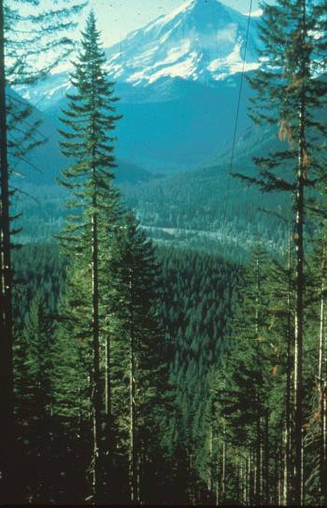
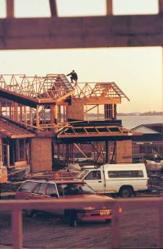
Forest Certification- Its Aim
Sustaining forests
Sustaining communities and economies

Slide 4
Forest Certification- Its Origin
Protests over impact of harvest in tropics.
UNCED Earth Summit, 1992
FSC creation by WWF and others.
SFI creation by AF&PA.
ENGO market campaigns
Global Trade Networks

Slide 5
What Is Driving Certification?
Some, but not all Environmental Groups
Some niche seeking forest product companies.
Environmental values reflected in purchase policies/building specifications.
Inability of forest industry to establish credible sustainability self claim.

Slide 6
The Montréal Process criteria are:
Maintenance of forest contribution to global carbon cycles.
Maintenance and enhancement of long-term multiple socio-economic benefits to meet the needs of societies.
Legal, institutional and policy framework for forest conservation and sustainable management.
Conservation of biological diversity.
Maintenance of productive capacity of forest ecosystems.
Maintenance of forest ecosystem health and vitality.
Conservation and maintenance of soil and water resources.

Slide 7
Forest Certification Systems
American Tree Farm System (ATFS)
Forest Stewardship Council (FSC)
Sustainable Forestry Initiative (SFI)
Programme for the Endorsement of Forest Certification (PEFC)

Slide 8
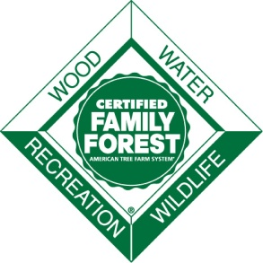
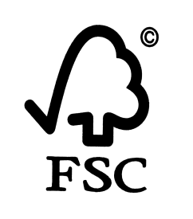
Certified Area in Oregon - 2009
Certification System |  | Area Certified | Percent of Oregon Forestland
 | Sustainable Forestry Initiative | 2,900,665 acres | 9.6%
 | American Tree Farm System | 807,508 acres | 2.7%
 | Forest Stewardship Council | 560,289 acres | 1.8%
 | Total Certified | 4,268,462 acres | 14.0%

Slide 9
Forest Certification Program Characteristics
Program | Third-Party Auditors | Chain-of-Custody | Public Reporting | Stake-holder Consultation | Independent Governance | On-Product Label
ATFS | Yes | Yes | Yes | Yes | Yes | No
FSC | Yes | Yes | Yes | Yes | Yes | Yes
SFI | Yes | Yes | Yes | Yes | Yes | Yes
PEFC | Yes | Yes | Yes | Yes | Yes | Yes
Source: Dovetail Certification Report. 2010

Slide 10
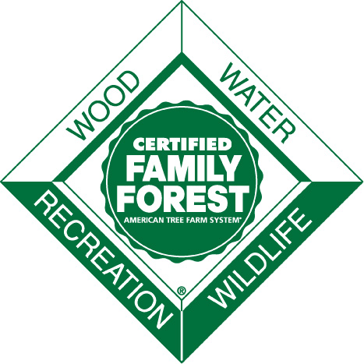
American Tree Farm System
Formed in 1941
Sponsor: American Forest Foundation
Volunteer auditors/Inspectors
Wood marketed through SFI companies.
Low cost alternative for family forest owners.
Recently endorsed by PEFC
Notes:
.

Slide 11
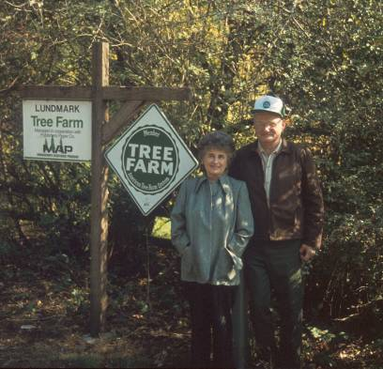
Growth of American Tree Farm System in the USA
Currently 90,000 members & 28 million acres.
Received $150 million endowment in 2007 from CSLA settlement.
Now a part of the Center for Family Forests.

Slide 12
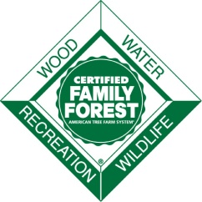
ATFS’s Standards of Sustainability
Commitment to Practicing Sustainable Forestry
Compliance with Laws
Reforestation and Afforestation
Air, Water & Soil Protection
Fish, Wildlife and Biodiversity
Forest Aesthetics
Protect Special Sites
Forest Product Harvests and other Activities

Slide 13
Forest Stewardship Council
International System with 40 country initiatives, 10 sustainable forestry principles, 57 indicators, and many regional standards.
FSC accredits certifiers and oversees rules and implementation.
Local Certifiers:
Smart Wood
Scientific Certification Systems
Northwest Natural Resource Grp
PricewaterhouseCoopers
Chain of Custody
Tracks product from forest to consumer – shows source
FSC Product Label
Used by Certificate holders

Slide 14
FSC’s Ten Principles
Compliance with Laws
Tenure and Use
Indigenous Rights
Communities and Worker Rights
Forest Benefits
Environmental Impact
Management Plan
Monitoring
High Conservation Value Forests
Plantations

Slide 15
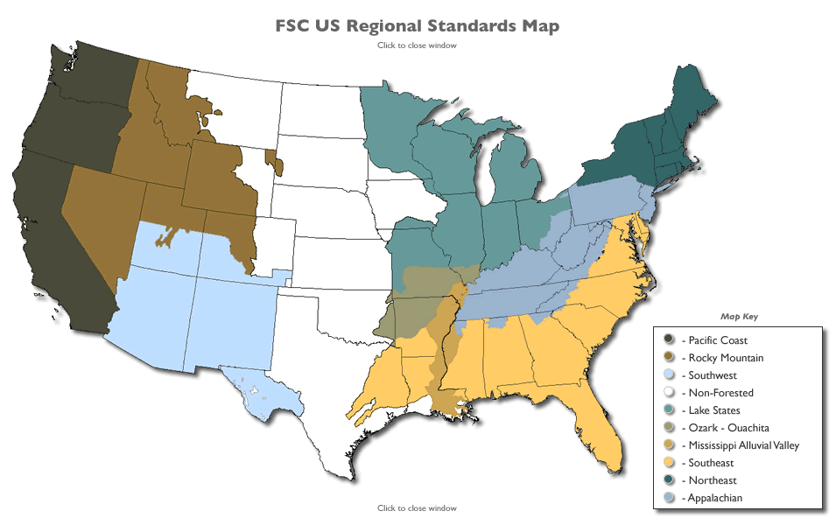

Slide 16
Sustainable Forestry Initiative
North American Sustainable Forest Management program
Geared toward intensive management for wood production
Major protections for biodiversity, water quality and sustained yield
Recognizes Best Management Practices as outlined by states for Clean Water Act
Works well in western OR and WA even aged systems
Promotes Logger Training and Certification
Chain-of-Custody
Product label
allows mixed source wood

Slide 17
Sustainable Forestry Initiative
Based on Montreal Protocol
an international sustainable forestry framework for Temperate Forests
Recognized by PEFC
Recognizes American Tree Farm System & Canadian Standards Association
Managed as a Non-Profit
Third-party audit by Organizations like
PricewaterhouseCoopers
KPMG Performance Registrar
QMI-SAI Global
Registered as an ANSI Process

Slide 18
SFI Principles of Sustainable Forestry
Sustainable Forestry
Forest Productivity and Health
Protection of Water Resources
Protection of Biological Diversity
Aesthetics and Recreation
Protection of Special Sites
Responsible Fiber Sourcing Practices in North America
Avoidance of Controversial Sources and Illegal Logging
Legal Compliance
Research
Training and Education
Public Involvement
Transparency
Continual Improvement

Slide 19
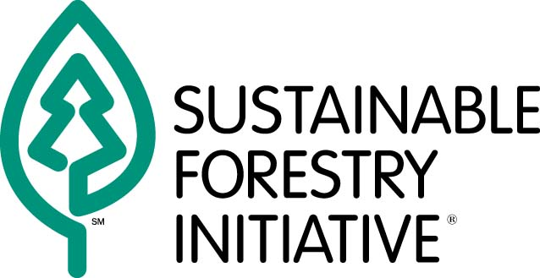
Umbrella Certification
or
or

Slide 20
Program for the Endorsement of Forest Certification (PEFC)
Purpose is the assessment of and mutual recognition of national forest certification schemes.
Based on intergovernmental processes such as the Montreal Process- C&I’s.
PEFC has in its membership 29 independent national forest certification schemes

Slide 21
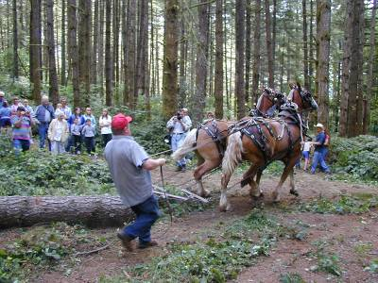
What Topics Are Covered in a Certification Assessment?
Management Plans
Forest Operations
Environmental Protection
Community/Neighbor Relations

Slide 22
Issues Separating FSC and SFI/ATFS/PEFC
Herbicide Use (reduce and eliminate future use)
Clearcut size (6 acres without retention in PNW)
Stream buffers (150 feet for fish and domestic water streams)
Genetically Modified Organism’s
Reserves-Older Forests
Social Obligations to Workers and Communities (Larger Owners)
Plantations Replacing Natural Forests

Slide 23
Forest Certification Websites
http://www.treefarmsystem.org/
www.us.fsc.org
www.sfiprogram.org
http://www.pefc.org
http://www.dovetailinc.org/

Slide 24
THANK YOU

